Slide 1
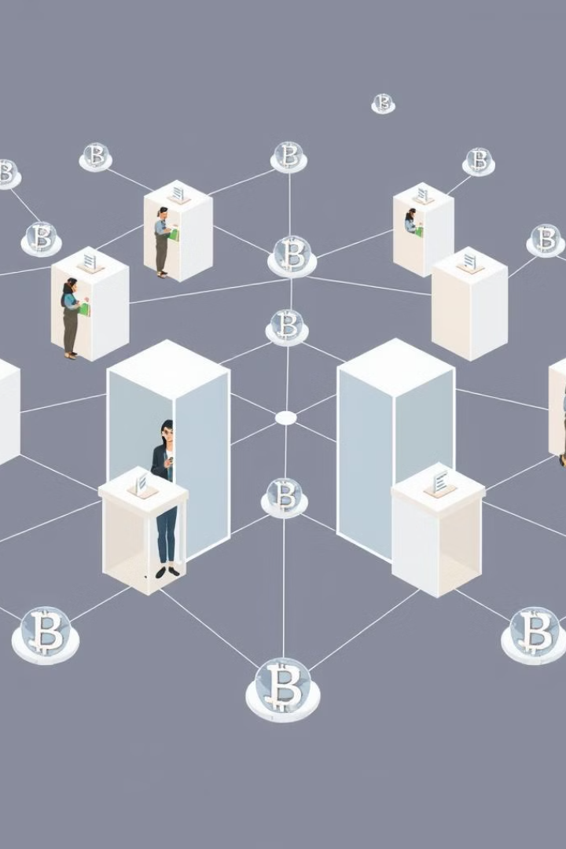
Decentralized Voting Application
This decentralized voting application harnesses the power of blockchain technology to enable secure, transparent, and tamper-resistant voting processes. By leveraging smart contracts and a distributed network, we aim to create a voting system that empowers citizens and strengthens democratic processes.

Slide 2

Introduction to Decentralized Voting
1
Transparent Voting
2
Secure Identity Verification
The decentralized nature of the application ensures that all votes are recorded on the blockchain, creating a transparent and immutable audit trail.
Cryptographic techniques are used to verify voter identities and prevent fraudulent voting, ensuring the integrity of the electoral process.
3
Decentralized Governance
The voting process is governed by smart contracts, eliminating the need for centralized authorities and reducing the risk of manipulation.

Slide 3

Solidity Smart Contract Development
1
Contract Design
Carefully design the smart contract structure and functionality to handle voting processes, including ballot creation, vote casting, and tallying.
2
Solidity Implementation
Implement the smart contract logic using the Solidity programming language, ensuring secure and efficient execution on the Ethereum network.
3
Testing and Deployment
Thoroughly test the smart contract to validate its correctness and security, then deploy it to the Ethereum network for public use.

Slide 4

Setting up Ethereum Network
Ethereum Client
Development Environment
Network Configuration
Set up a local Ethereum client, such as Geth or Parity, to interact with the Ethereum network and deploy smart contracts.
Configure a development environment, including tools like Truffle and Ganache, to streamline the smart contract development and testing process.
Customize the Ethereum network settings, such as gas limits and block times, to optimize the performance and security of the voting application.

Slide 5
Integrating Solidity with React JS
Web3.js Integration
Contract Interaction
State Management
Utilize the Web3.js library to connect the React.js frontend with the Ethereum network, enabling interaction with the deployed smart contract.
Implement functions to call the smart contract's voting-related methods, such as creating ballots, casting votes, and tallying results.
Manage the application's state, including voter information, ballot details, and voting results, using React.js state management techniques.

Slide 6
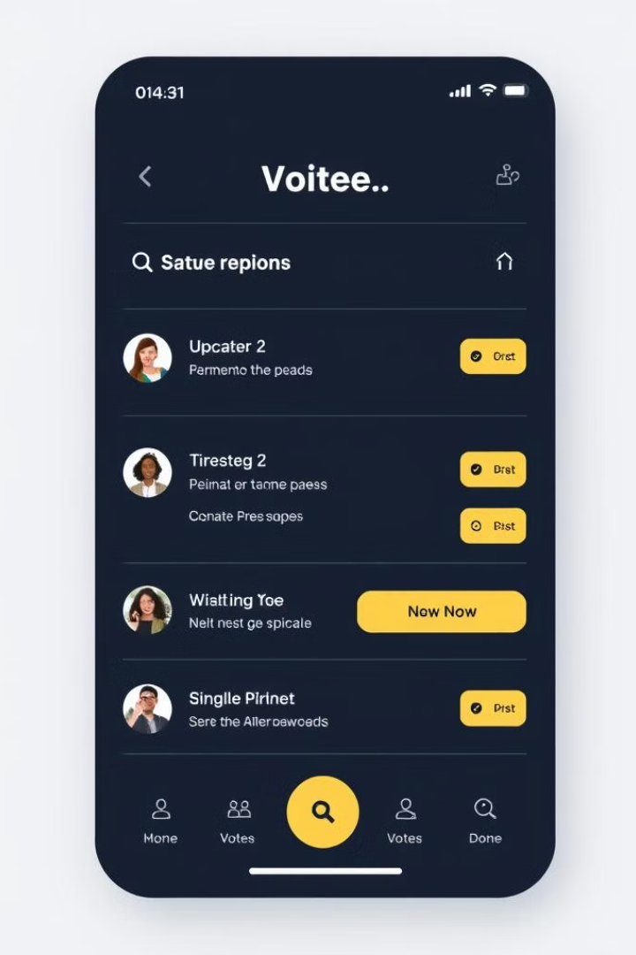



Building the Front-end User Interface
Voter Interface
Develop a user-friendly interface for voters to access the voting process, including ballot viewing, vote casting, and result tracking.
Admin Console
Create an administrative interface for managing the voting process, such as ballot creation, voter registration, and result reporting.
Blockchain Integration
Seamlessly integrate the front-end with the underlying blockchain infrastructure, ensuring a smooth and transparent user experience.

Slide 7





Features and Functionality
Ballot Creation
Voter Registration
Vote Casting
Result Tracking
Allow authorized users to create and publish voting ballots on the decentralized network.
Implement a secure voter registration process to verify voter identities and eligibility.
Enable voters to cast their votes securely and anonymously on the blockchain.
Provide real-time tracking and transparency of voting results throughout the electoral process.

Slide 8

Deployment and Demo
Deployment
Package the decentralized voting application, including the smart contract and front-end, for seamless deployment on a cloud platform or a distributed network.
Demo
Showcase the full functionality of the decentralized voting application, highlighting its secure, transparent, and tamper-resistant features.

